Slide 1

Writing Centre Services

Slide 2
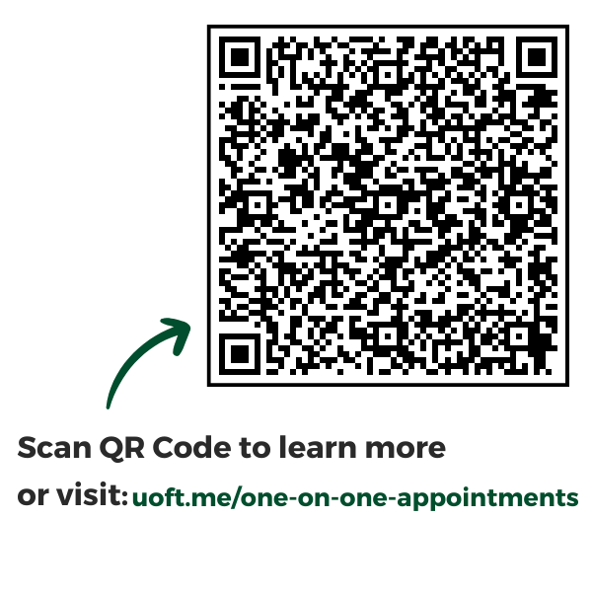
One-On-One Appointments
50 minute, 1:1 session with a Writing Centre instructor
Available in-person or online
Supports students across disciplines
Tailored to your specific needs and wherever you are in the writing process

Slide 3

The Writing Room
Drop-in, no appointment needed
In-person Mondays and Thursdays from 3-6 pm in Wilson Hall
Work independently or with support from our instructors and librarians

Slide 4
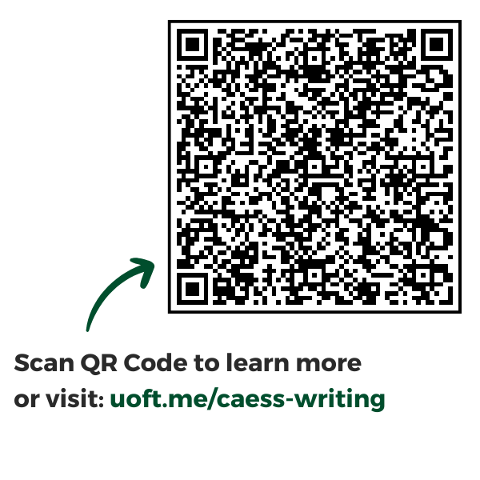
CAESS Writing Group
Meets most Tuesdays in the library and some Fridays online
Work alongside peers (and snacks!) with support from instructors, faculty members, and librarians
Open to students in at least one Caribbean, African or Equity and Solidarity Studies course

Slide 5


Slide 6


Thank you!
Visit us in the Writing Centre
Wetmore Hall
300 Huron Street
Rm: 60A, 60B, 60K & 61
uoft.me/writing-centre
newcollege.writingcentre@utoronto.ca

